Slide 1
2D Viewing and Clipping
Revision 1.3
Copyright 2006: Zachary Wartell,
University of North Carolina at Charlotte,
All Rights Reserved
Textbook:
Chapter 6
, Larry F. Hodges
©Zachary Wartell

Slide 2
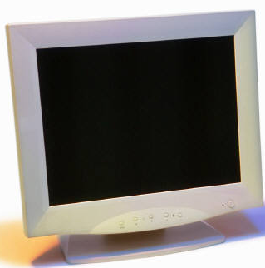
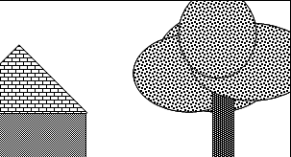
View Window and Viewport
View/Clipping Window
No WIMP/GUI Component in OS
Information outside
the viewport is
clipped away
Viewport
, Larry F. Hodges
©Zachary Wartell

Slide 3
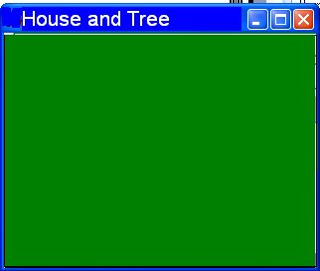
View Window,Viewport, Display Window
View/Clipping Window
OS with WIMP Component
Information outside
the viewport is
clipped away
Viewport
Display Window
, Larry F. Hodges
©Zachary Wartell

Slide 4
Terminology
World Coordinate System (Object Space) – Virtual object’s coordinates are stored in this coordinate system using application defined units of measure (ft., inches, etc.).
Clipping/View Window - The rectangle defining the part of the world we wish to display. [Rectangle specified in World Coordinates]
Display/Screen/Device Coordinate System - The coordinate system of the framebuffer.
Display Window - The graphics application’s window on the screen on computers with a WIMP interface component. Display Window coordinate system moves with the window. [Window Rectangle specified in Display Coordinates]
Viewport - The rectangle within the screen (or display window) defining where the image will appear. (Default is usually entire screen or display window.) [Viewport rectangle specified in Display Window or Screen Coordinates]
Viewing Transformation - The process of going from a view window in world coordinates to a viewport in screen coordinates.
, Larry F. Hodges
©Zachary Wartell

Slide 5
Viewing Transformation
Choose View Window in
World Coordinates
Clip to size
of View Window
Translate to
origin
Scale to size of Viewport
Translate to proper position on screen
(display window)
, Larry F. Hodges
©Zachary Wartell

Slide 6
Notes on Viewing Transformation
Panning - Moving the view window about the world coordinate space
Zooming - Reducing the view window size
As the view window increases in size, the image in the viewport decreases in size and vice versa
Beware of aspect ratio.
, Larry F. Hodges
©Zachary Wartell

Slide 7
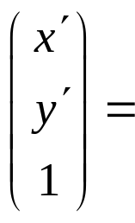
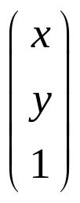
Viewing Transformation Example
Viewport
(10, 30)
(50, 30)
(0, 1)
(0.5, 1)
View
Window
0.375,0.75)
(35, 14.5)
(0, 0.5)
(0.5, 0.5)
(0.5, 0.5)
(10, 5)
(50, 5)
X scale = 0.5/40 = 1/80
(1 , 0)
(0,0)
1 0 0
0 1 0.5
0 0 1
1/80 0 0
0 1/50 0
0 0 1
1 0 -10
0 1 -5
0 0 1
3) Translate to
proper
coordinates
2) Scale to correct
size
1) Translate window
to origin
, Larry F. Hodges
©Zachary Wartell

Slide 8
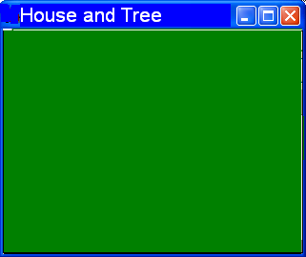
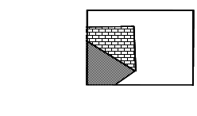

Other Examples
View Window
45◦
Display Window
©Zachary Wartell

Slide 9
OpenGL Clipping
(-1,1)
( 1,1)
( -1,-1)
( 1,-1)
Choose View Window in
World Coordinates
Scale & Translate into
Normalized Device Coordinates
for clipping
Scale to size of Viewport
WIMP component (if present) translates to
screen coordinates
Translate to Viewport Origin
©Zachary Wartell

Slide 10
Clipping
(xl, yt)
(xr, yt)
A point is visible if
xl < X < xr
and
yb < Y < yt
(xl, yb)
(xr, yb)
A line is visible if both of its end points are in the window.
Brute Force Method - Solve simultaneous equations for intersections of all lines with all window edges.
, Larry F. Hodges
©Zachary Wartell

Slide 11
Cohen-Sutherland Algorithm
Region Checks: Trivially reject or accept lines and points then only do interaction computation on remaining lines
Fast for large windows (everything is inside) and for small windows (everything is outside).
Each vertex is assigned a four-bit outcode.
Bit 4 <-- sign bit of (yt-y) -- point is above window
Bit 3 <-- sign bit of (y-yb) -- point is below window
Bit 2 <-- sign bit of (xr-x) -- point is to right of window
Bit 1 <-- sign bit of (x-xl) -- point is to left of window
, Larry F. Hodges
©Zachary Wartell

Slide 12
Cohen-Sutherland Clipping (cont.)
Bit 4: Above
Bit 3: Below
Bit 2: Right
Bit 1: Left
1001
1000
1010
0001
0000
0010
0101
0100
0110
A line can be trivially accepted if both endpoints have an outcode of 0000.
A line can be trivially rejected if any corresponding bits in the two outcodes are both equal to 1. (This means that both endpoints are to the right, to the left, above, or below the window.)
©Zachary Wartell

Slide 13
Clipping Lines Not Accepted or Rejected
In the case where a line can be neither trivially accepted nor rejected, the algorithm uses a “divide and conquer” method.
D
Example:
C
B
A
H
E
F
G
Line AD: 1) Test outcodes of A and D --> can’t accept or reject.
2) Calculate intersection point B, which is conceptually on
the window side of the dividing line. Form new line
segment AB and discard the rest of the line because it is
above the window.
3) Test outcodes of A and B. Reject.
©Zachary Wartell

Slide 14
Polygon Clipping
•using line clipping not good enough
Not a polygon
©Zachary Wartell

Slide 15
Polygon Clipping
Need to maintain closed polyline boundary!
Note, clipping yields 2 polygons
©Zachary Wartell

Slide 16
Efficiency: Trivial Accept & Reject
Accept
Reject
Need Clipping
bounding box easy to compute
©Zachary Wartell

Slide 17
Sequentially Clip View Windows Edges
1
2
3
clip
right
clip
left
4
5
clip
bottom
clip
top
©Zachary Wartell

Slide 18
Clipping Against Edge
line embedding
top edge
outside
half-space
inside
half-space
Polygons can be clipped against each edge of the window one edge at a time. Window/edge intersections, if any, are easy to find since the X or Y coordinates are already known.
Vertices which are kept after clipping against one window edge are saved for clipping against the remaining edges. Note that the number of vertices usually changes and will often increase.
©Zachary Wartell

Slide 19
Edge Clipping: 4 Cases
p₄
p₃'
p₄
p₃'
p₃
p_{1'}
p_{1'}
p₁
p₂
p₁
The window boundary determines a visible and invisible half-space.
The edge from vertex i to vertex i+1 can be one of 4 types:
-Exit visible half-space - save the intersection
-Wholly outside visible half-space - save nothing
-Enter visible half-space - save intersection and endpoint
-Wholly inside visible half-space - save endpoint
©Zachary Wartell

Slide 20
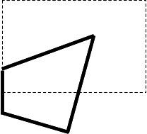
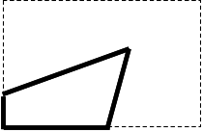
Complete Example
2
2'
3
2 ''
1'
I – In
O - Out
3'
1
Left Clip
Right Clip
Bottom Clip
Top Clip
(1,2) (I/I) → {2}
(2,3) (I/O) → {2'}
(3,1) (O/I) → {3',1}
(2,2'): (I/I) → {2'}
(2',3'): (I/I) → {3'}
(3',1): (I/I) → {1}
(1,2): (I/I) → {2}
(2',3'): (I/O) → {2''}
(3',1): (O/O) → {}
(1,2): (O/I) → {1',2}
(2,2'): (I/I) → {2'}
(2'',1'): (I/I) → {1'}
(1',2): (I/I) → {2}
(2,2'): (I/I) → {2'}
(2',2''): (I/I) → {2''}
©Zachary Wartell

Slide 21
Liang-Barsky Line Clipping: Observation
Use: p=p₁+u(p₂-p₁)
u₁=MAX({u of p. enter pt’s, 0})
u₂=MIN({u of p. exit pt’s, 1})
i_{R}
u>1
i_{T}
p₂
u₂=1
u∈[0,1]
i_{L}
u₁=0.45
p₁
i_{B}
u<0
potential entrance
potential exit
©Zachary Wartell

Slide 22
Liang-Barsky Line Clipping: Observation
p=p₁+u(p₂-p₁)
i_{R}
u>1
i_{T}
p₂
u₂=1
u∈[0,1]
i_{L}
u₁=0.25
p₁
i_{B}
u<0
potential entrance
potential exit
©Zachary Wartell

Slide 23
Liang-Barsky Line Clipping: Observation
p=p₁+u(p₂-p₁)
i_{R}
u>1
p₂
i_{T}
u₂=1
u∈[0,1]
p₁
u₁=0
u<0
i_{L}
i_{B}
potential entrance
potential exit
©Zachary Wartell

Slide 24
Liang-Barsky Line Clipping: Observation
p=p₁+u(p₂-p₁)
u>1
p₂
i_{R}
i_{T}
u∈[0,1]
u₂=0.5
p₁
u<0
u₁=0
i_{L}
i_{B}
potential entrance
potential exit
©Zachary Wartell

Slide 25
Liang-Barsky Line Clipping: Observation
p₂
u>1
p=p₁+u(p₂-p₁)
u∈[0,1]
i_{R}
p₁
u<0
u₁= 0
i_{T}
u₂= -1/6
Opps! u₁ > u₂
i_{L}
i_{B}
potential entrance
potential exit
©Zachary Wartell

Slide 26
Liang-Barsky Line Clipping: Observation
p=p₁+u(p₂-p₁)
i_{R}
i_{T}
u>1
i_{L}
p₂
u₁=1.25
u∈[0,1]
u₂=1
Opps! u₁ > u₂
i_{B}
p₁
potential entrance
u<0
potential exit
©Zachary Wartell

Slide 27
Liang-Barsky: Algorithm
p=p₁+u(p₂-p₁)
wx_{max}
wx_{min}
i_{R}
u>1
wy_{max}
i_{T}
p₂
u₁ u₂
start 0 1
xmin u(i_{L}) 1
xmax u(i_{L}) 1
ymin u(i_{L}) 1
ymax u(i_{L}) 1
u₂=1
u∈[0,1]
i_{L}
u₁=0.45
p₁
i_{B}
u<0
wy_{min}
potential entrance
potential exit
©Zachary Wartell

Slide 28
Liang-Barsky: Algorithm
p=p₁+u(p₂-p₁)
wx_{max}
wx_{min}
i_{R}
u>1
wy_{max}
p₂
i_{T}
u₂=1
u_{l} u_{u}
start 0 1
xmin 0 1
xmax 0 1
ymin 0 1
ymax 0 1
u∈[0,1]
p₁
u₁=0
u<0
i_{L}
i_{B}
wy_{min}
potential entrance
potential exit
©Zachary Wartell

Slide 29
Liang-Barsky: Algorithm
p=p₁+u(p₂-p₁)
u>1
p₂
wx_{min}
i_{R}
wy_{max}
i_{T}
u∈[0,1]
u₂=0.5
u₁ u₂
start 0 1
xmin u(i_{L}) 1
xmax u(i_{L}) u(i_{R})
ymin u(i_{L}) u(i_{R})
ymax u(i_{L}) u(i_{T})
u₁=1/3
i_{L}
i_{B}
p₁
wy_{min}
u<0
potential entrance
potential exit
©Zachary Wartell

Slide 30
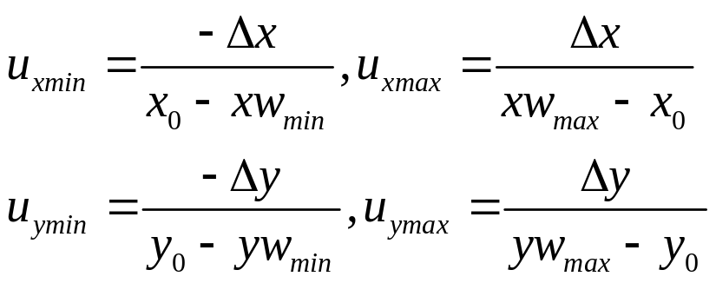
Liang-Barsky: Pseudo-Code
•Conceptually:
  Test and update u₁ and u₂ against each of 4 edges of clip window and
  if u₁ and u₂ swap positions
  return empty intersection
  otherwise
  use u₁ and u₂ to compute actual entrance and exit points
•Details:
-compute u of intersection with each window edge as follows:
-horizontal or vertical lines: when numerator = 0 test
sign of denominator
separated coordinate
equations of
p=p₁+u(p₂-p₁)
©Zachary Wartell

Slide 31
Liang-Barsky vs Cohen-Sutherland
LB generally more efficient:
  LB: updates of u₁ and u₂ use one division, window intersections computed only once with final u₁ and u₂
  CS: may repeatedly calculate intersections along a line, even if line is totally exterior to clip window and each intersection computation uses division and multiplication
©Zachary Wartell

Slide 32
Nicholl-Lee-Nicholl Line Clipping
generate region codes (Cohen-Suther.) & use trivial accept and reject
when trivial case fails further subdivide regions:
  consider p₀ in 1 of 3 regions (other cases can be handled from symmetry)
Corner
p₀
Inside
Edge
p₀
p₀
©Zachary Wartell

Slide 33
Nicholl-Lee-Nicholl: p₁ subcases
for each possible region (inside,corner,edge) for p₀ further subdivide space into semi-infinite triangles based on possible locations for p₁
Inside Case for p₀
T(op)
R(ight)
L(eft)
p₀
B(ottom)
©Zachary Wartell

Slide 34
“Edge” case sub-regions for p₁
4 regions
LT
L
p₀
L
LR
L
LB
©Zachary Wartell

Slide 35
“Corner” case sub-regions for p₁ (subcase I)
5 regions
p₀
T
T
TR
L
LB
TB
©Zachary Wartell

Slide 36
“Corner” case sub-regions for p₁ (subcase II)
5 regions
p₀
T
TR
L
L
LR
LB
©Zachary Wartell

Slide 37
Determining region of p₁
•We determine the region of p₁ by comparing slopes
of line p₀p₁ and the line from p₀ to the corners of the
clipping window that define the different regions
(L,LT, etc.)
•For example
p₁ is in LR when
slope(p₀p_{BR}) < slope(p₀p₁) < slope(p₀p_{TR})
and
p₁.x < wx_{max} (determined from standard region outcode)
LT
p_{TR}
L
p₁
p₀
L
LR
L
p_{BR}
LB
©Zachary Wartell

Slide 38
Nicholl-Lee-Nicholl versus CS & LB
•using more regions avoids multiple line-intersection tests of Cohen-Sutherland (CS)
•compared to both CS and Liang-Barsky (LB), NLN performs fewer comparisons and divisions
•however, CS and LB can be applied to 3D clipping. NLN can’t extend to 3D.
©Zachary Wartell

Slide 39
Weiler-Atherton Polygon Clipping
Weiler-Atherton (WA) better suited to clipping concave polygons and can clip concave polygons to concave polygon shaped clipping windows
Instead of following a path only along edges of concave polygon, we allow path to also follow the clipping window boundary whenever a polygon edge crosses to the outside of that boundary
©Zachary Wartell

Slide 40
Weiler-Atherton Polygon Clipping: CW or CCW?
Weiler-Atherton (WA) requires we know whether vertex list is clock-wise (cw) or counter-clockwise (ccw) so that we can be sure to traverse the list in a known order. Either:
  graphics pipeline must have already thrown out polygons of the undesired order (backface removal)
  Or we used cross-product of consecutive edges to determine order (cw or ccw)
If WA algorithm uses cw traversal polygon interior is always on right. If WA algorithm uses ccw traversal, polygon interior is always on left.
p₁
p₃
p₀
p₁
p₀
p₀
On right
(cw)
On left
(ccw)
p₂
p₁
p₂
p₃
p₃
p₂
©Zachary Wartell

Slide 41
Weiler-Atherton Polygon Clipping: Algorithm
1) process polygon edges CCW until we find edge that exits clipping window
2) Now instead of following polygon edge, follow the clipping window edges in CCW direction starting at the exit point. Continue following clipping window boundary until you encounter another polygon edge intersection. If this intersection is previously visited goto 3. If intersection point is new, start following polygon edges in CCW until a previously processed vertex is found
3) Created a vertex list from the visited vertices in (1) and (2)
4) Return to the exit-intersection point in (1) and continue following polygons edges in using steps 1-3.
©Zachary Wartell

Slide 42
Weiler-Atherton Polygon Clipping: Algorithm
2
2'
1'
1''
(1, 1', 1'', 1''')
3
1
1'''
6
5'
5
4'
(4', 5, 5')
4
©Zachary Wartell

Slide 43
Clipping to nonrectangular clip windows
●Parametric clipping algorithms such as Liang-Barsky can be adapted for clipping against nonrectangular convex clip regions
-quick reject: compare bounding boxes
-use inside-outside tests and process parametric edge
equations of both polygon and clipping polygon
●Weiler-Atherton can be adapted for clipping against nonrectangular concave clip regions
-two vertex-list in same order (cw or ccw)
-inside-outside test to see if polygon inside clip region
-alternately follow polygon boundary and clip region boundary
p₀
©Zachary Wartell

Slide 44
Curve Clipping
approximate with polygons/lines and use line/poly. clipping
Compute intersections of non-linear equations
  quick reject: use bounding box intersection tests
  use symmetry of curve to improve quick rejection
  when must compute non-linear intersections save results for use by scan-line algorithm
©Zachary Wartell

Slide 45
Text Clipping
Text as lines/polygons clip lines/polygons
Text as bitmaps: clip extents of rectangular bitmap to clip window (often part of hardware bitblt operation)
For efficiency add levels of quick reject/accepts:
  test bounding rectangle of string against clip window
  test bounding rectangle of individual characters against clip window
What Frog
©Zachary Wartell

Slide 46
Revisions
1.1 – synchronized Liang-Barsky notation with textbook
1.2 – typo on slide 36
1.3 - typos
©Zachary Wartell

